Slide 1
Logic-Circuits Ex1.8
Dutescu horia ionut

Slide 2

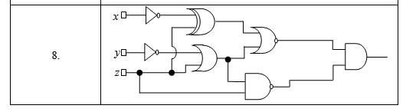
Problem Statement

Slide 3
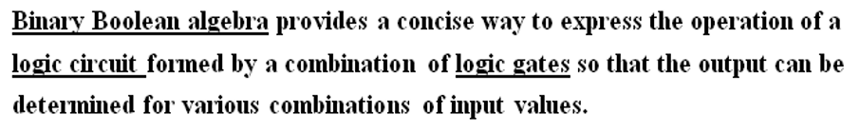
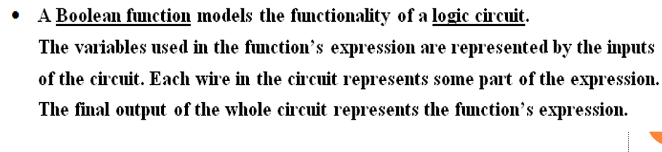
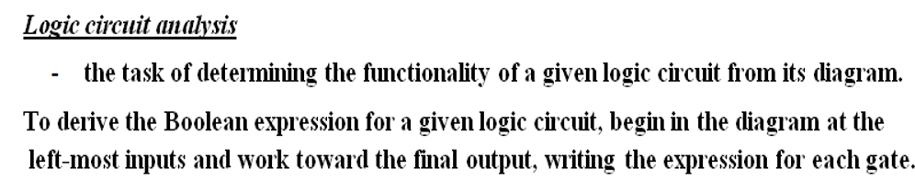
Theory:

Slide 4
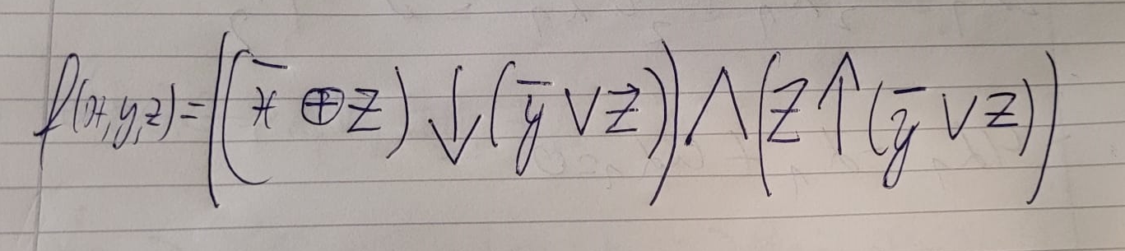
The corresponding Boolean function is:

Slide 5
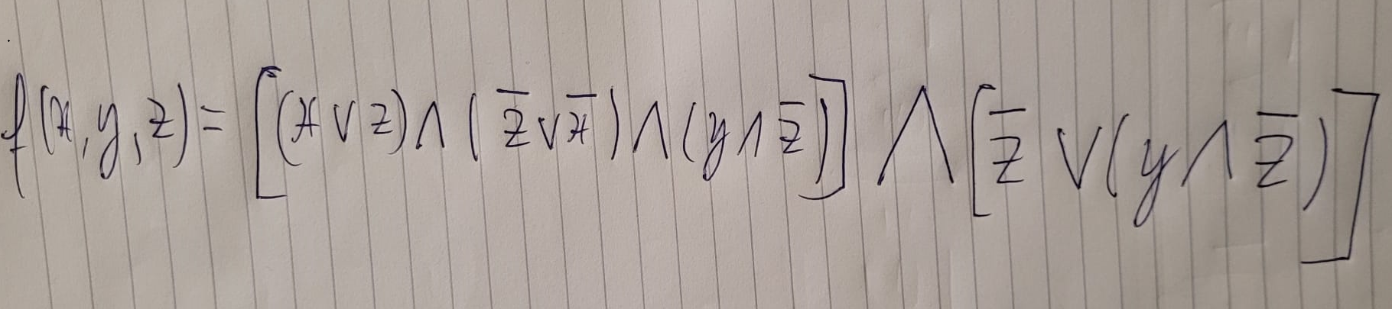
The simplified version of the Boolean function using only AND, OR, NOT is :

Slide 6
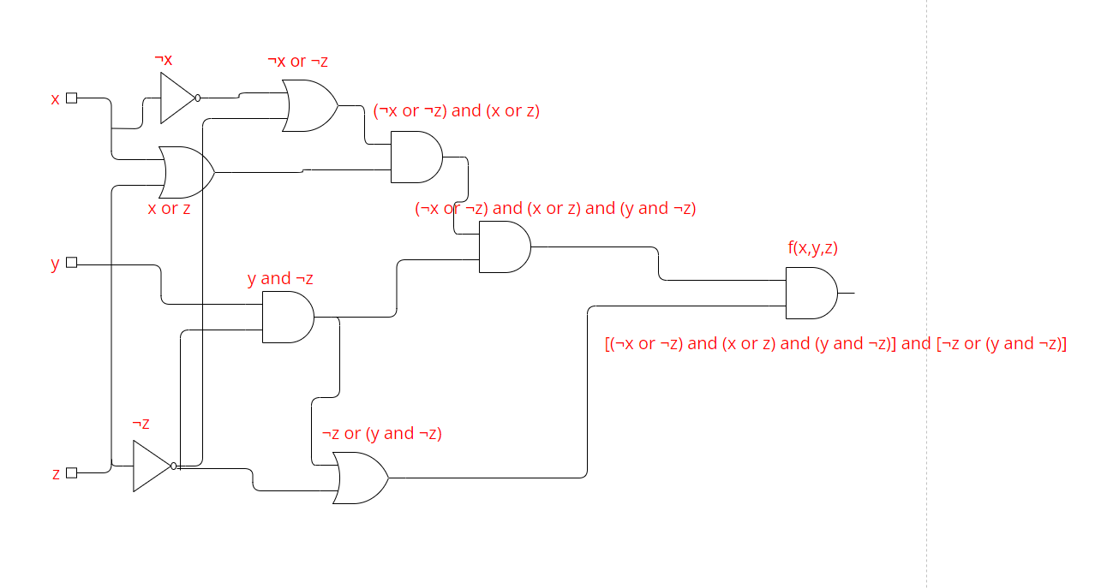
The equivalent logic circuit using only basic gates is :

